Slide 1



Slide 2


Predicting Fraudulent Financial Transactions
“In the evolving landscape of financial security, this project focuses on the strategic enhancement of transaction monitoring systems using advanced machine learning techniques. By concentrating on fraud detection in mobile financial transactions, we aim to develop a robust model capable of accurately predicting fraudulent activities in real-time. This initiative seeks to strengthen security measures, minimize financial losses, and provide actionable insights into patterns and factors contributing to transaction fraud, thereby enabling more informed decision-making and fostering trust in digital financial platforms.”
Presented By: Prathyusha

Slide 3
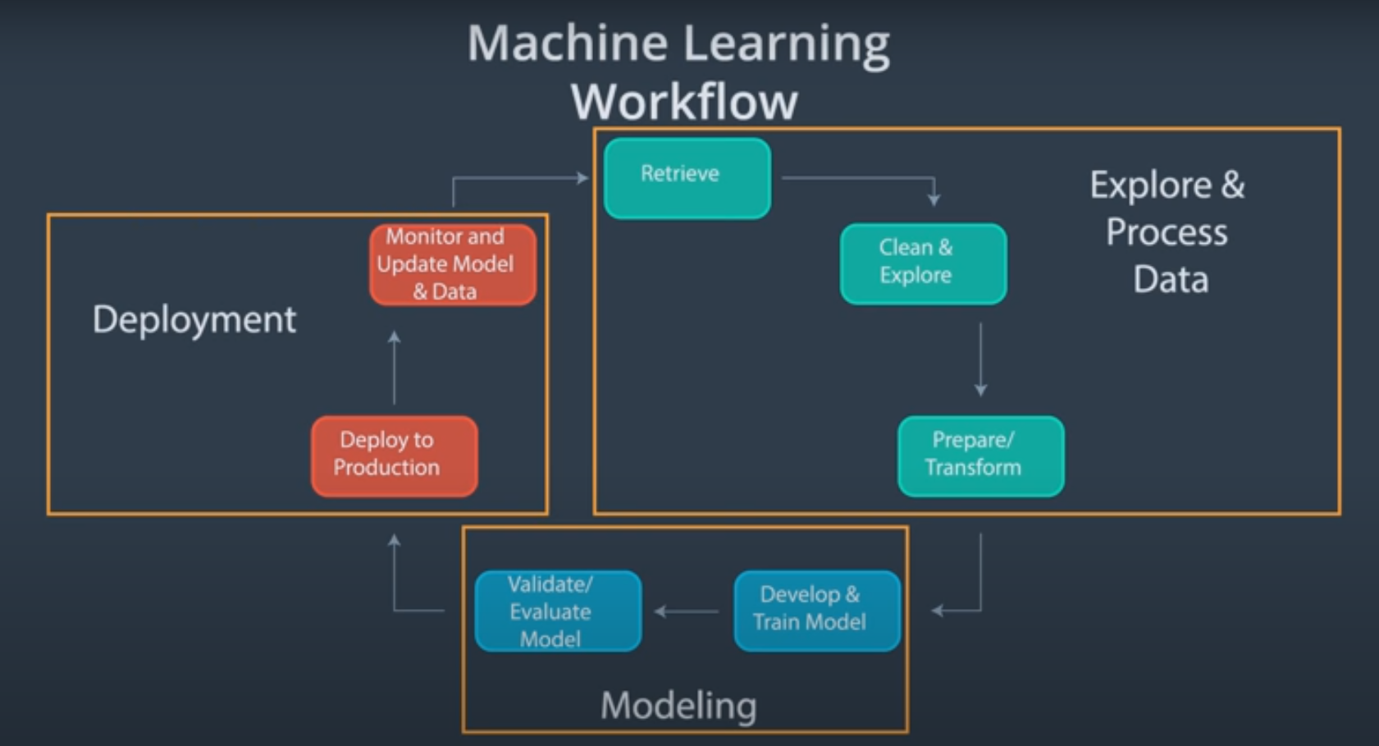

Slide 4
INTRODUCTION
Fraudulent transactions in mobile financial systems refer to unauthorized or deceptive activities that can lead to significant financial losses. Detecting fraud early is critical to protecting both customers and organizations. Leveraging data science and machine learning models allows financial institutions to predict and prevent fraudulent transactions in real-time, enabling proactive measures and minimizing potential losses.
“This dataset provides a comprehensive overview of mobile financial transactions, focusing on factors that help identify fraudulent activities and patterns in user behaviour.”
“The dataset encompasses 11 key features such as transaction type, amount, origin and destination balances, customer IDs, and fraud indicators.”
“The target variable, ‘isFraud,’ indicates whether a transaction is fraudulent, helping to identify suspicious financial activities.”

Slide 5
OBJECTIVE
Develop an accurate machine learning model to identify and predict fraudulent financial transactions in real-time.
Analyze transaction patterns and model performance using metrics like precision, recall, F1-score, and ROC-AUC.
Minimize financial losses and improve security by providing actionable insights into fraud patterns and potential risk factors.

Slide 6
DATA COLLECTION
Data collection is the systematic process of gathering, organizing, and recording information relevant to a specific purpose.
Dataset Name: Fraud Detection Dataset (Financial Transactions Simulation)
Content: Records of financial transactions including transaction type, amount, sender and recipient details, balances before/after transaction, and fraud labels.
Source: Simulated dataset (commonly used in research and academic projects for fraud detection).
Purpose:
To detect fraudulent financial transactions.
To build and evaluate machine learning models for fraud detection.

Slide 7
DATA COLLECTION
Dataset Name: Fraud Detection Dataset (Fraud_Analysis_Dataset(in).csv
Columns: The dataset contains transaction details such as step, type, amount, sender/receiver IDs, balances before and after transactions, and a fraud label. These features capture both customer activity and fraud indicators.
Purpose: The dataset is designed to study transaction behavior and detect fraudulent activities. It helps build predictive models for preventing financial fraud.
Applications: It can be applied in banking, credit card fraud detection, online payment security, and real-time fraud monitoring systems. These applications improve financial safety and reduce losses.
Analysis Tasks: The dataset is used for exploratory data analysis, feature engineering, model building, and evaluating fraud detection performance. It also supports financial impact assessment of fraud prevention.

Slide 8
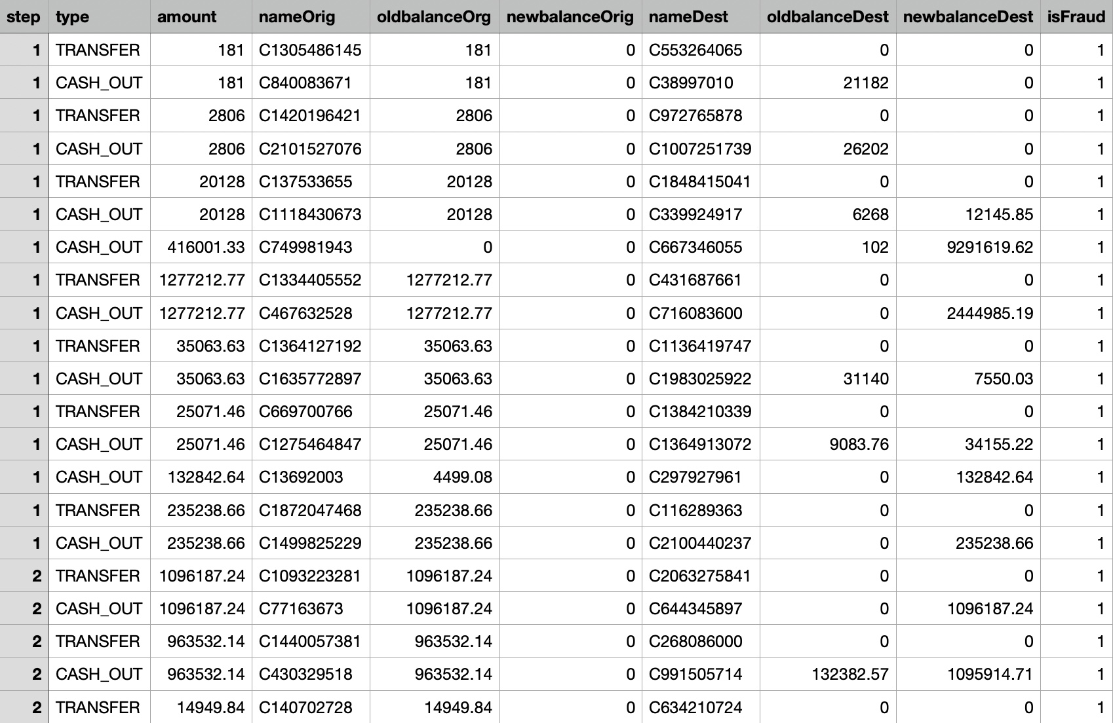
Dataset: Fraud Analysis Dataset

Slide 9
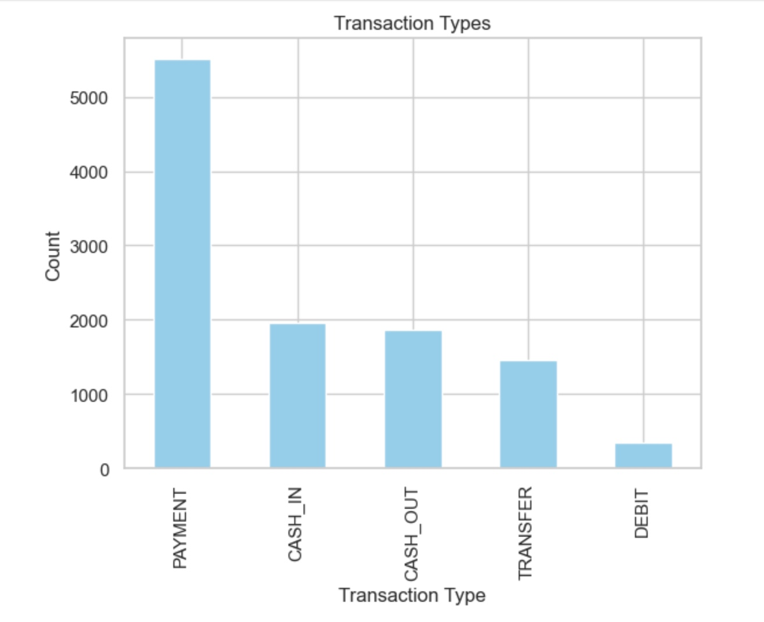
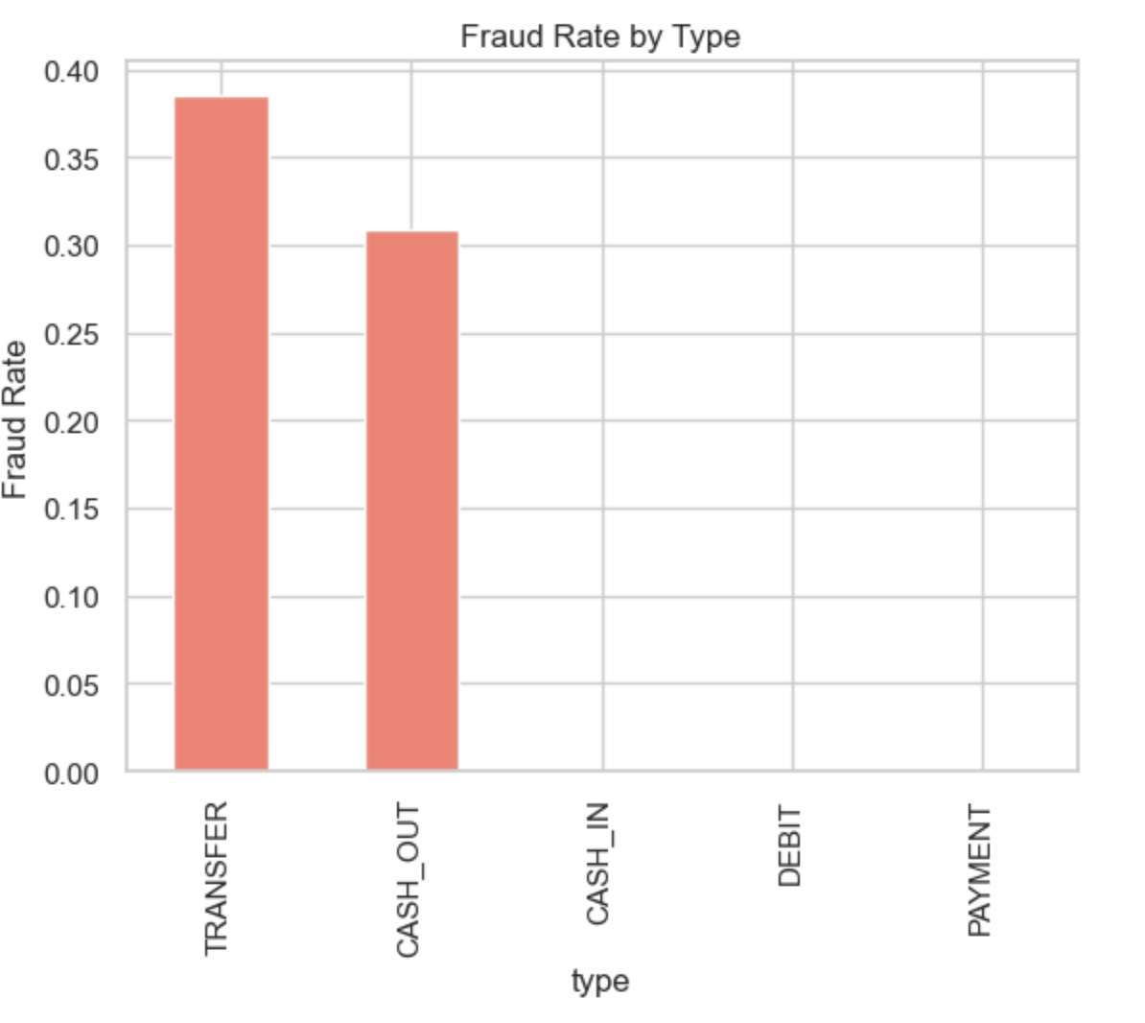
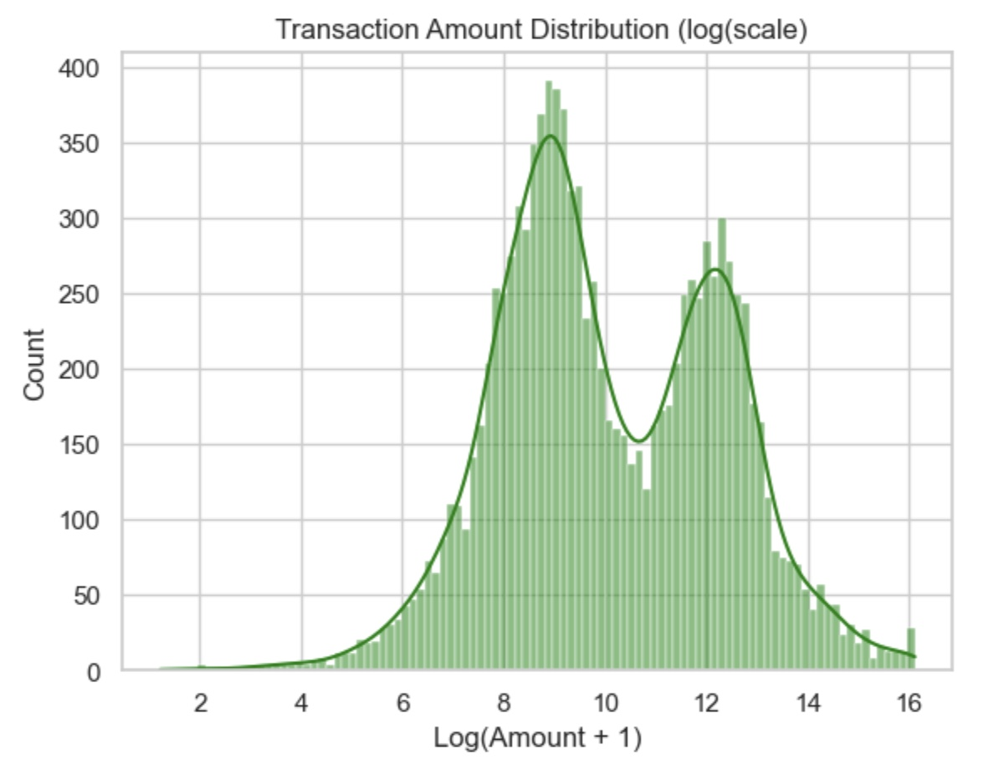
Exploratory Data Analysis(EDA)
Transaction Types
Fraud Rate by Type
Transaction Amount Distribution

Slide 10
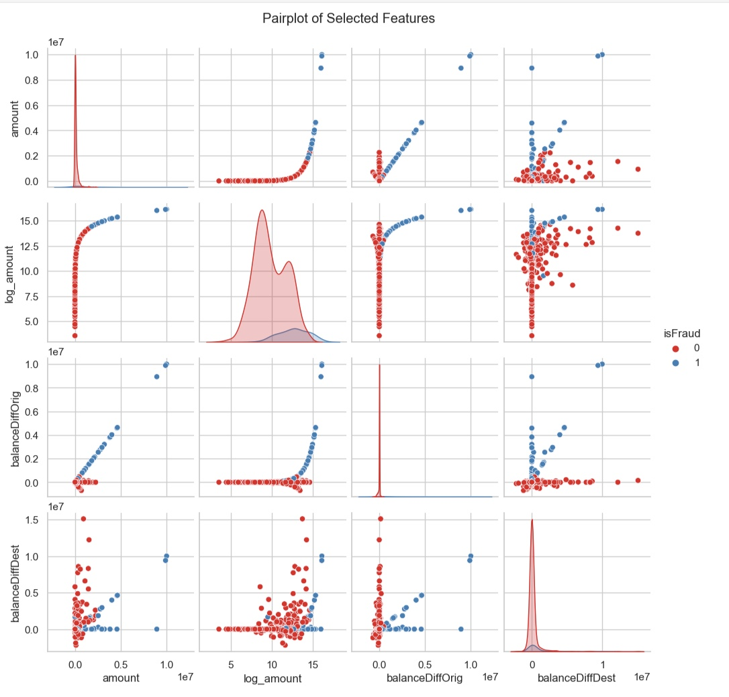
Pairplot of Selected Features

Slide 11
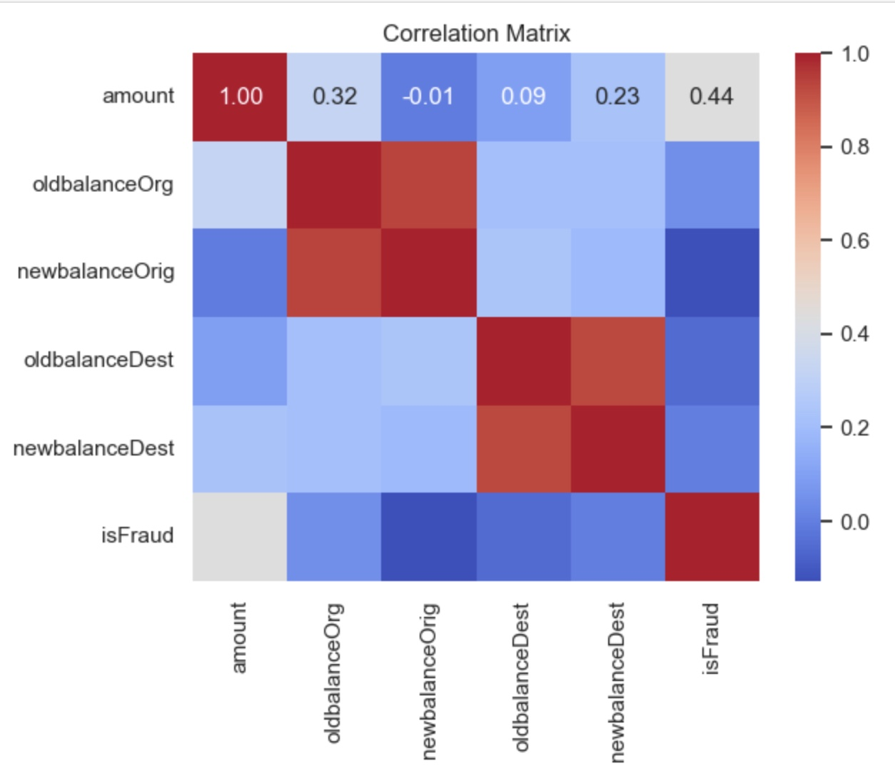
oldbalanceOrg and newbalanceOrig are highly correlated because sender’s new balance depends on old balance minus the amount.
oldbalanceDest and newbalanceDest are also highly correlated since recipient’s new balance depends on old balance plus the amount.
amount shows moderate correlation with oldbalanceOrg (0.32) and isFraud (0.44), meaning transaction size influences fraud detection.
amount has weak correlation with oldbalanceDest (0.23) and almost no correlation with newbalanceOrig (-0.01).
isFraud has very weak correlation with most balance features, but moderate correlation with amount, showing fraud is more linked to transaction size.
Red areas indicate strong positive correlation, while blue areas indicate weak or negative correlation.

Slide 12
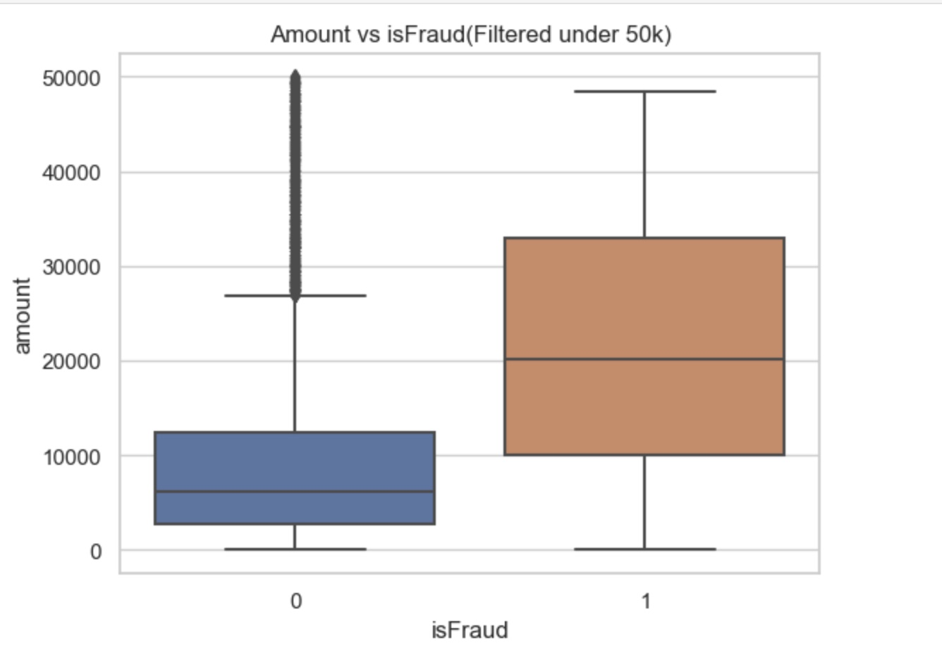
Fig:Outliers

Slide 13
Handling Outliers
Log Transformation:
Applied np.log1p() on the amount column to reduce the effect of extreme transaction values.
This transformation compresses large amounts into a smaller scale, making the data distribution more normal and less skewed.
Visualized the transformed values using a boxplot grouped by isFraud.
Winsorization:
Applied winsorize() to cap extreme values in the amount column.
Lower 1% of values were increased to the 1st percentile, and upper 1% were reduced to the 99th percentile.
This limits the influence of extreme outliers without removing data points.
Visualized the winsorized values using a boxplot grouped by isFraud.

Slide 14
Feature Engineering
A ColumnTransformer is created to handle preprocessing of different column types.
Numeric features (numeric) → scaled using StandardScaler() to normalize values (mean = 0, std = 1).
Categorical features (categorical) → encoded using OneHotEncoder(drop="first") to convert categories into binary columns, dropping the first category to avoid dummy variable trap.
remainder="drop" → any columns not listed in numeric or categorical are dropped from the dataset.

Slide 15
Handling Class Imbalance
Fraudulent transactions are much rarer than normal ones, causing class imbalance.
To address this issue:
Applied preprocessing (scaling + encoding) to training and test sets.
Used SMOTE (Synthetic Minority Over-sampling Technique) on the training set to generate synthetic fraud samples → balanced dataset.
Kept the test set untouched to ensure fair evaluation on the real-world distribution.

Slide 16
Model Selection
Logistic Regression
Used as a baseline model with balanced class weights.
Provides interpretability and good fraud detection accuracy.
Random Forest
Ensemble of decision trees with balanced class weights.
Handles non-linear patterns and improves fraud detection.
Gradient Boosting
Sequential boosting of weak learners.
Captures complex patterns for better predictive power.
Support Vector Machine (SVM)
Polynomial kernel with balanced classes.
Effective in separating fraud vs non-fraud transactions.
AdaBoost (Adaptive Boosting)
Ensemble method that combines multiple weak learners (usually decision stumps).
Boosts performance by giving higher weight to misclassified transactions in each round.

Slide 17
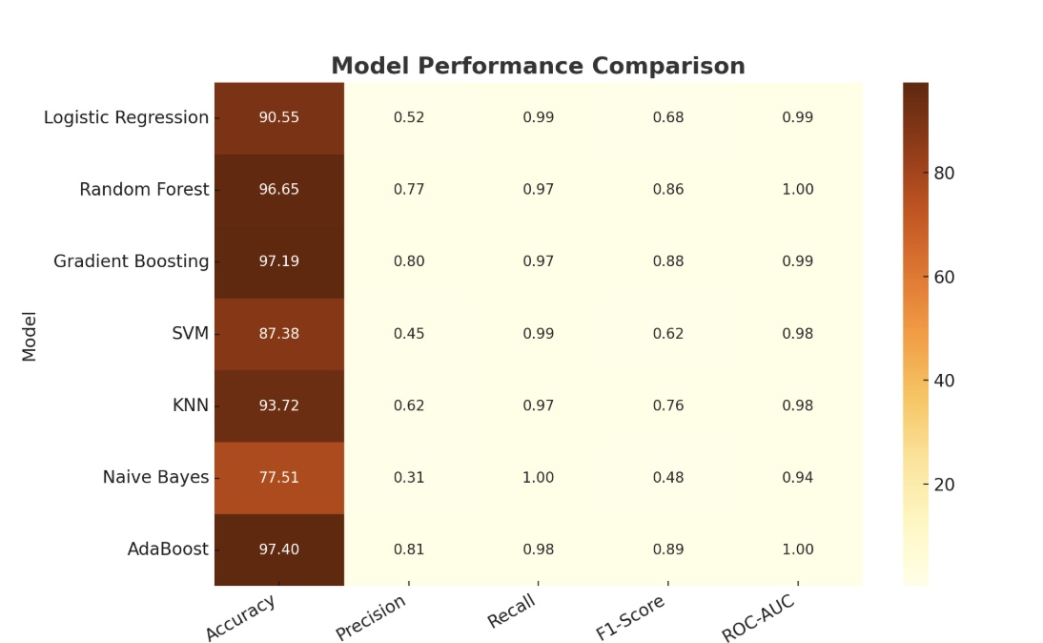
Model Performance
Understandings from the Table:
AdaBoost
Precision (0.81) and Recall (0.98) are both strong.
Accuracy (97.40%) close to Random Forest.
Performs almost as well as Random Forest, with slightly better Recall.
Random Forest
Precision: 0.77, Recall: 0.97 → very balanced.
Highest Accuracy (96.65%) with AdaBoost models.
Strong candidate for fraud detection as it minimizes both false positives and false negatives.
Gradient Boosting
Accuracy is moderate (97.19%), Recall is high (0.97).
Detects only a small or large fraction of frauds → best for fraud detection.
SVM (Support Vector Machine)
Recall is very high (0.99) → almost all frauds are caught.
Precision is 0.45, leading to many false alarms.
Experimentation Results:
Logistic Regression achieved perfect precision but had lower recall, missing some fraud cases.
SVM excelled in recall, catching almost all frauds, but produced more false positives.
AdaBoost and Random Forest achieved the best balance between precision and recall.
AdaBoost stood out with the highest accuracy (97.40%) and a strong F1-score.
Its ROC-AUC score (0.99) confirms that it distinguishes fraudulent from non-fraudulent transactions more effectively than other models

Slide 18
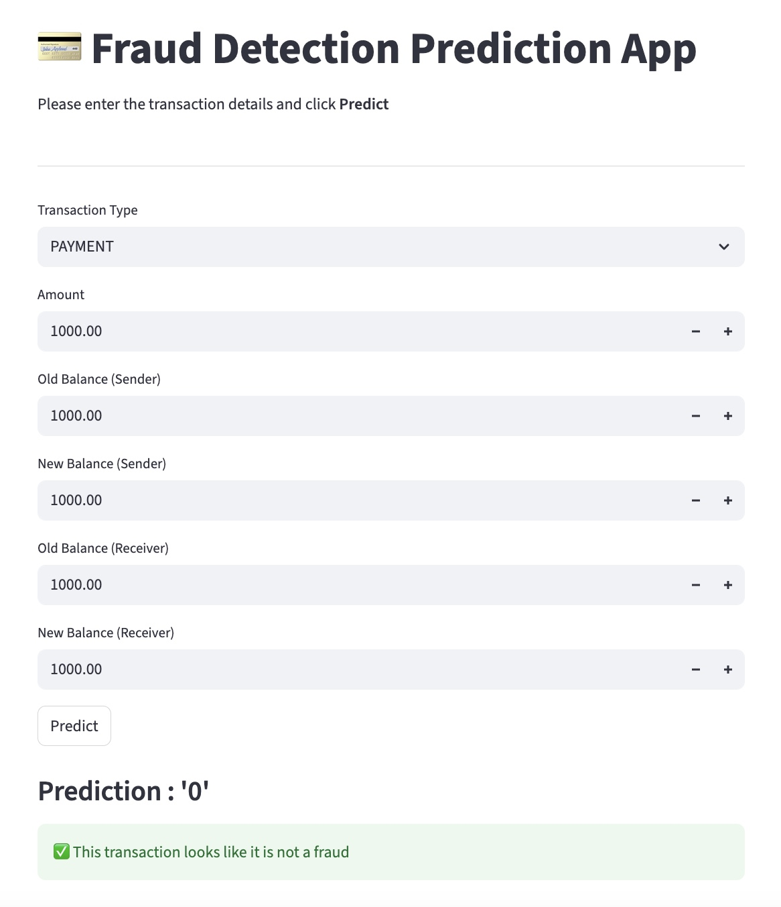
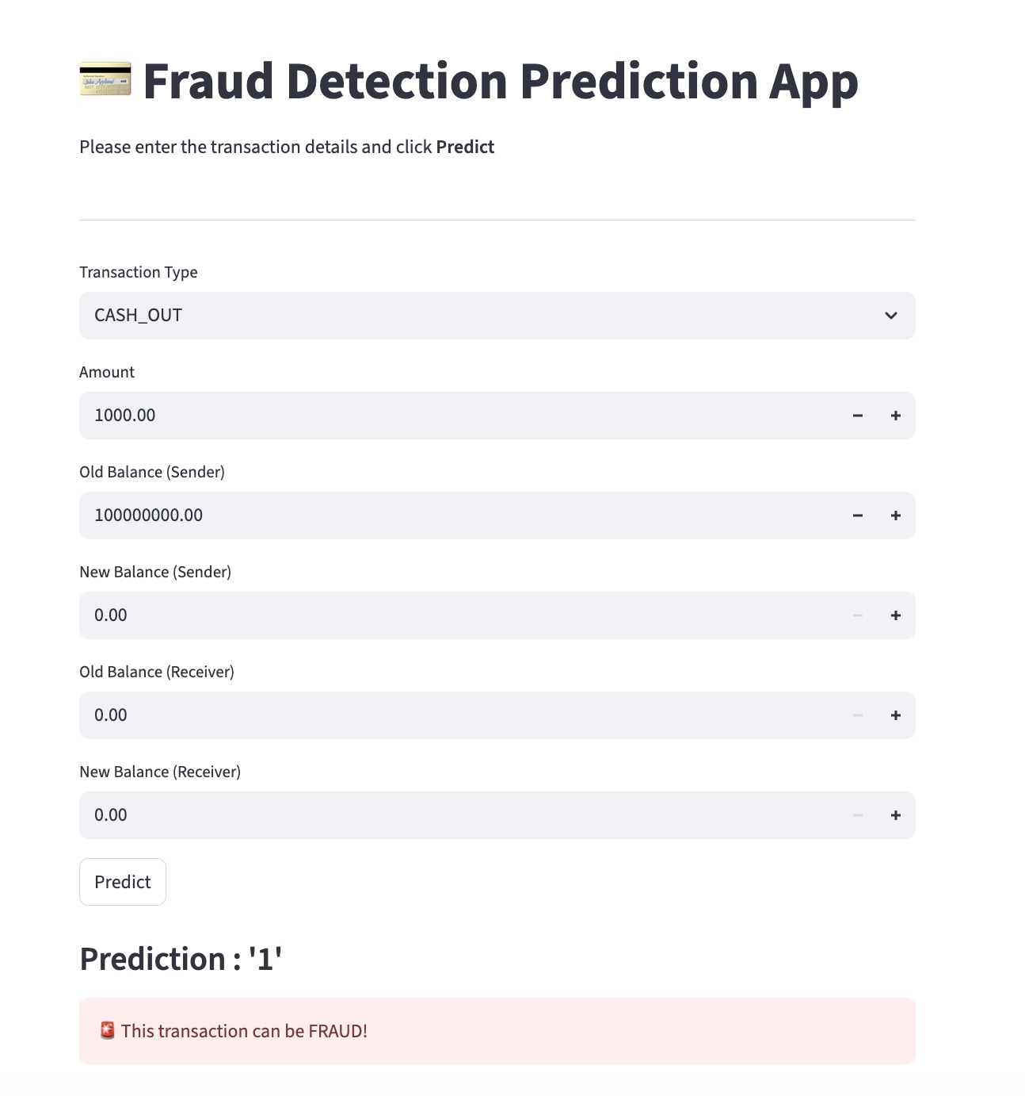
Model Deployment

Slide 19
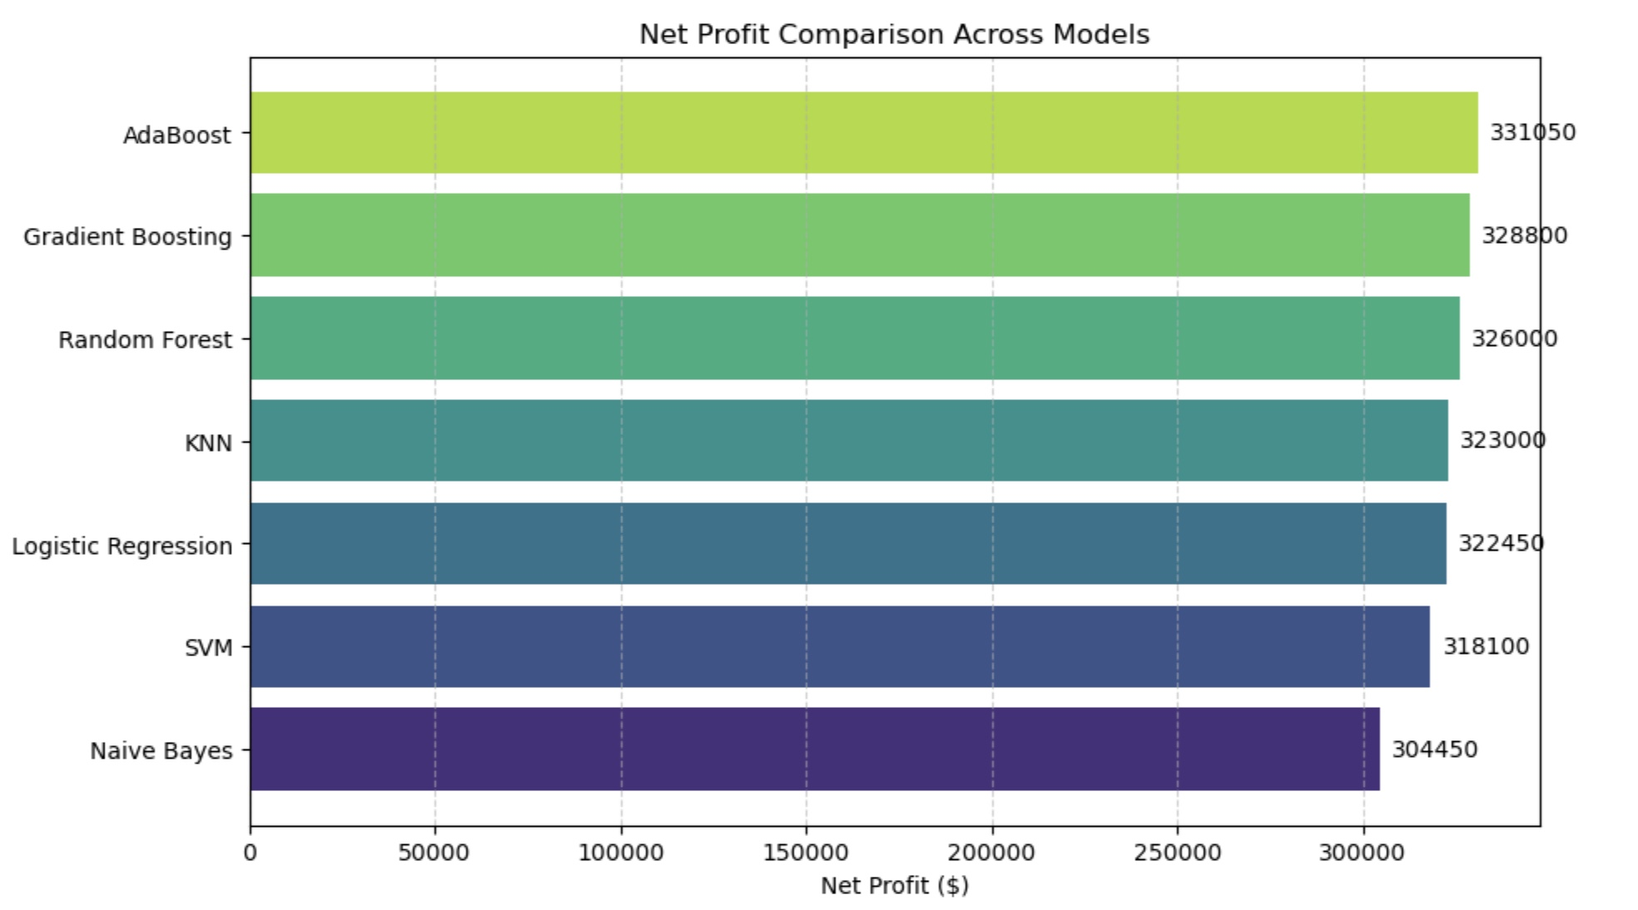
Financial Impact Analysis
Why AdaBoost is Best
Highest Net Profit (331,050) → Outperforms all other models financially.
Excellent Recall (0.97) → Detects the majority of fraudulent transactions.
Strong Precision (0.81) → Keeps false positives at a reasonable level.
High F1-Score (0.88) → Balanced trade-off between fraud detection and accuracy.
Competitive ROC-AUC (0.997) → Almost perfect separation of fraud vs. non-fraud.

Slide 20
Business Questions to Address
How reliable is the model in classifying transactions as legitimate or fraudulent?
What is the model's precision and accuracy in detecting fraudulent transactions?
What are the potential losses due to model errors?

Slide 21
Business Recommendations
Business Recommendations for Fraud Detection:
Implement a system to detect suspicious transactions automatically.
Combine automated detection with simple business rules for better accuracy.
Focus investigations on high-risk transactions to save time and resources.
Reduce unnecessary investigations by lowering false alerts.
Track how much money is saved by preventing fraud to measure success.
Ensure customers are not inconvenienced by incorrect fraud alerts.
Keep records of all fraud cases for audits and compliance.
Use fraud patterns to improve business decisions and prevent future losses.

Slide 22
CONCLUSION
Key Findings :
Highest Net Profit (331,050) → Financially the most beneficial model.
Strong Accuracy (97.39%) and the best Recall (0.98) → Detects almost all fraud cases.
Limitations:
Slightly lower precision (0.81) compared to Random Forest (0.99), which means more false positives and higher investigation costs.
Sensitive to noisy data & outliers since boosting gives higher weight to misclassified cases.
Future Research / Improvements:
Cost-sensitive AdaBoost → Incorporating fraud costs directly into the algorithm to better handle false positives.
Hybrid Models → Combine AdaBoost with Random Forest or deep learning for improved precision without sacrificing recall.

Slide 23
Questions?

Slide 24
Thank you!

